Slide 1
HIT OR FLOP?
Directed BY – group E
Vanessa Caldera
Matthew Hill
Tim Tieng

Slide 2
Problem Statement
Utilizing open movie data provided by the dataset, “TMDB 5000 Movie Dataset” provided by Kaggle, can a team of Data Scientists effectively predict or determine the factors that influence a movie’s popularity rating?

Slide 3
Update 2 - Summary
Group E focused on data cleaning and exploratory data analysis on the movies dataset for this update. Group E created initial visualizations to facilitate further analysis on our dataset. Group E utilized concepts taught in class to complete project milestones.

Slide 4











To Do
In Progress
In Review
Complete

Slide 5
1. Genre Vs Voting Average 2. Popularity Vs Run Time 3. Popularity Vs Budget
Bi-Variable Analysis

Slide 6
Determining the Runtime Effects in RStudio
#How many movies fall in each
length(shortetruntimes$popularity)
671
length(longestruntimes$popularity)
17
#Librarying
library(ggplot2)
library(tidyverse)
library(imputeTS)
library(readr)
#Mean of the shortest variables
mean(shortestruntimes$runtime)
83.77124
mean(shortestruntimes$popularity)
12.15499
#Mean of the longest variables
mean(longestruntimes$runtime)
173.6725
mean(longestruntimes$popularity)
42.35088
#Reading the file
df <- read.csv("/Users/vanessacaldera/Desktop/Syracuse University/Intro to Data Science/Final Project/Final Project Dataset.csv", header=TRUE,stringsAsFactors = FALSE)
df$runtime <- na_interpolation(df$runtime)
df$popularity <- na_interpolation(df$popularity)
#Put it all together
df <- df %>% arrange(df$runtime)
##Take away the 0
df <- df[-1:-35, ]
#Linear models
shortmodel <- lm(formula= popularity ~ runtime, data= shortestruntimes)
longmodel <- lm(formula=popularity ~ runtime, data=longestruntimes)
originalmodel <- lm(formula=popularity ~ runtime, data=df)
#Summary of linear models
summary(shortmodel)
R-Squared: 0.01491
summary(longmodel)
R-Squared: 0.009518
summary(originalmodel)
R-Squared: 0.04889
##Mean of the original df after cleaning
mean(df$runtime)
107.6543
mean(df$popularity)
2.15165
#Creating short and long runtime subsets
shortestaruntimes <- df[df$runtime > 150, ]
longestruntimes <- df[df$runtime <90, ]

Slide 7
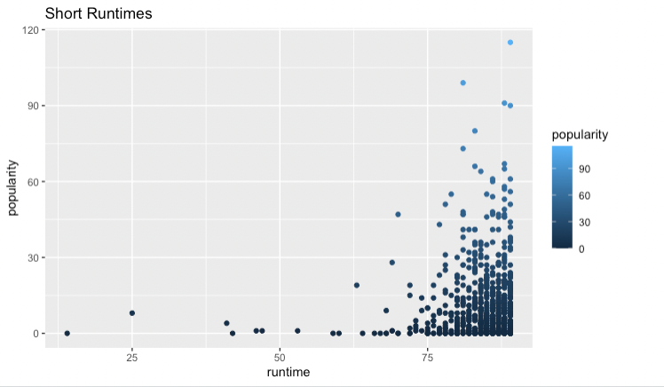
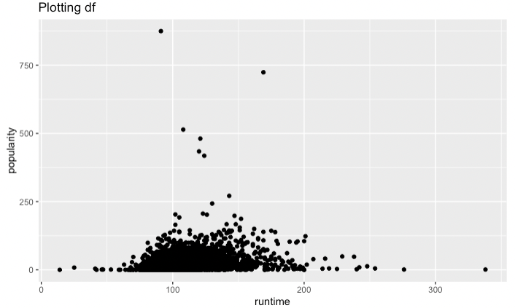
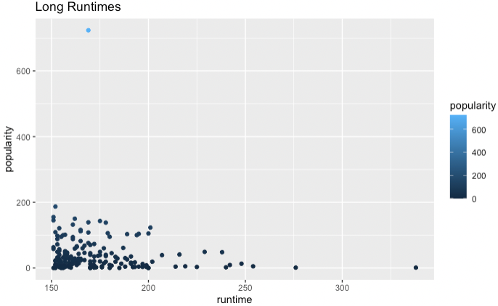
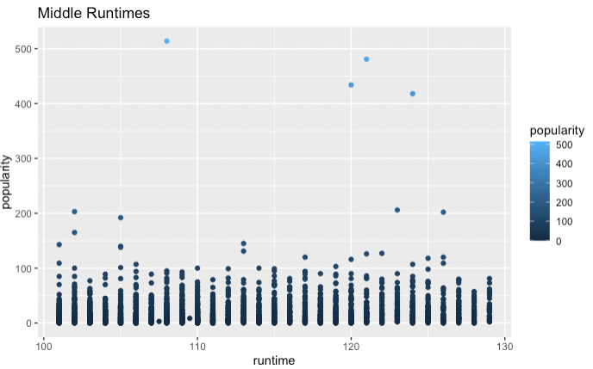
Plotting Runtime with Popularity in RStudio
#Plotting
ggplot(df) + aes(x=runtime, y=popularity) + geom_point()
ggplot(shortestruntimes) + aes(x=runtime, y=popularity) + geom_point(aes(color=popularity))
ggplot(longestruntimes) + aes(x=runtime, y=popularity) + geom_point(aes(color=popularity))
ggplot(middleruntimes,aes(x=runtime, y=popularity)) + geom_point(aes(color=popularity))

Slide 8
Popularity VS Movie Budget
Question – Determine if there is a relationship between a movie’s production budget and its popularity? Group E wants to determine if the more money invested to create a movie is a good starting point to conduct multi-variate analysis.
Assumption 1 – The dataset reflects an accurate representation of the population for a given movie, during a specific time frame
Assumption 2 – Although the dataset has 20 attributes, we will only be analyzing ones we believe have a relationship (initially)
Assumption 3 – Budget is an important attribute for predictive analysis, but in conjunction with other attributes

Slide 9
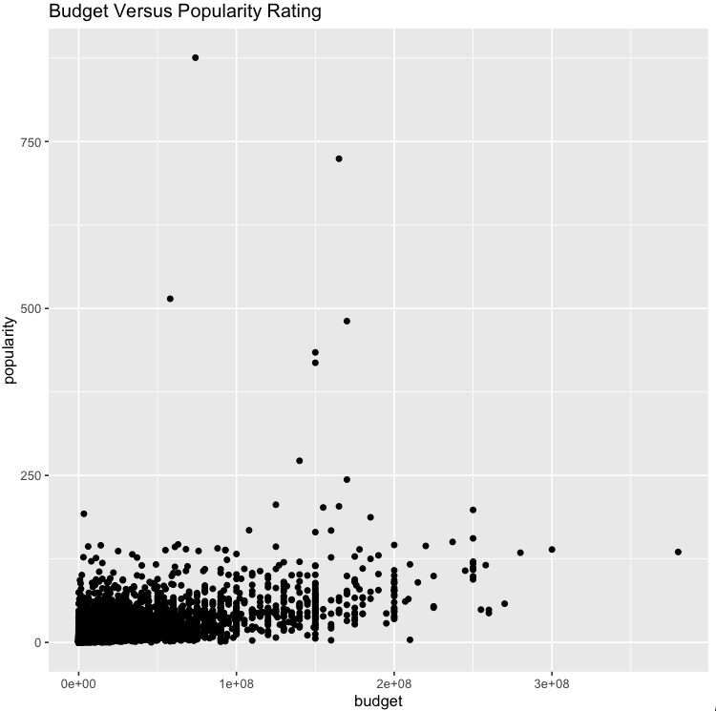
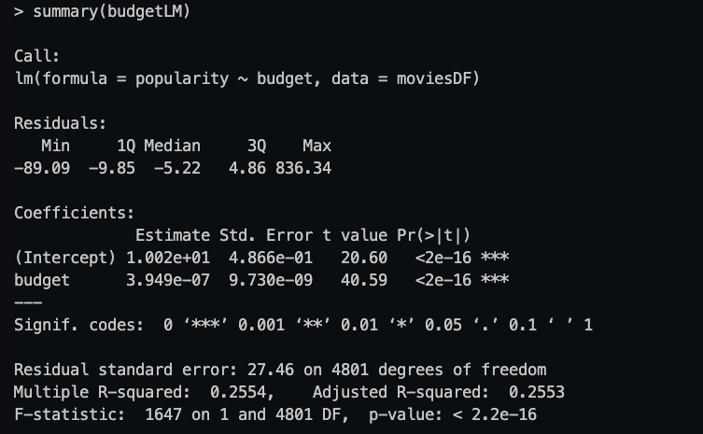
Popularity VS Budget

Slide 10
Popularity vs Budget - Analysis
Based off the output of the summary() function, Interpretation is authorized
The adjusted R-Squared – 0.2553.
This can be interpreted as approximately 25.5% of change in popularity ratings can be attributed to the budget attribute.
Scatterplot –
The resulting scatterplot shows that the dataset generally clusters in the lower left hand portion of the graph.
There are a few outliers that are displayed outside the typical x and y range for this dataset; Omission of some of these outliers may be required to create an accurate model
Bottom Line Up Front – Group E believes that multi-variable analysis is required to increase the adjusted R-squared value. However, it is interesting to see that one variable can influence 25% of change in popularity ratings. This suggests that budget is one of the key factors that influences movie popularity.

Slide 11
Genre Vs. Votes/Voting Average
Does the Genre of the movie affect the number of votes it receives?
Anecdotally, Horror movies receive less views and votes than other genres
These fewer votes tend to trend low

Slide 12
Genre Vs. Votes/Voting Average
Analyzing the Vote quantity and values compared between main genre
Sort Dataset by genres, creating subsets by genre
Analyze each for total votes and average vote value
Compare Horror Genre value to other Genres
Does the Anecdotal analysis stand up to data analysis?

Slide 13
Update 3 Expectations
Continue analysis to understand which combination of attributes influences movie popularity rating (Adjusted R-Squared Value)
Create Visualizations that support our analysis/ claims
Reformat Final Project Slidedeck for presentation

Slide 14
Appendices
This section will serve as a repository to demonstrate Group E’s code that facilitated their analysis

Slide 15
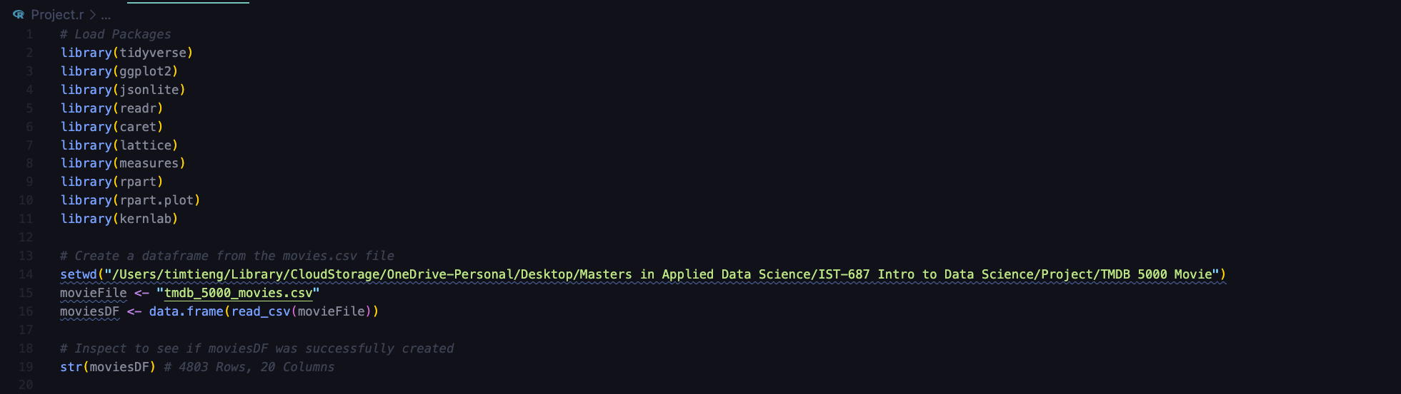
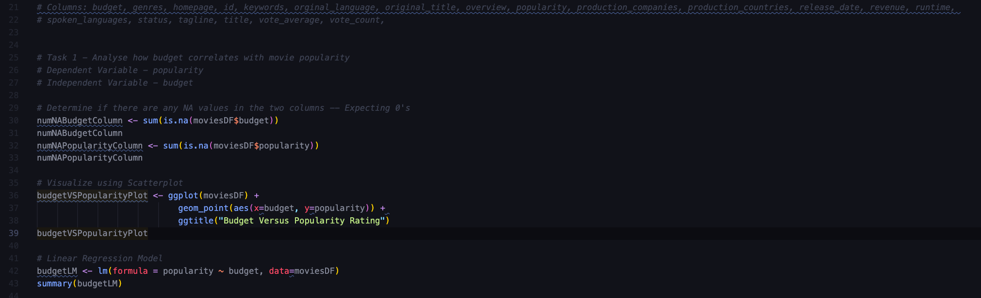
Popularity Vs Budget - Code
**Redacted Personal File Path**

